Slide 1

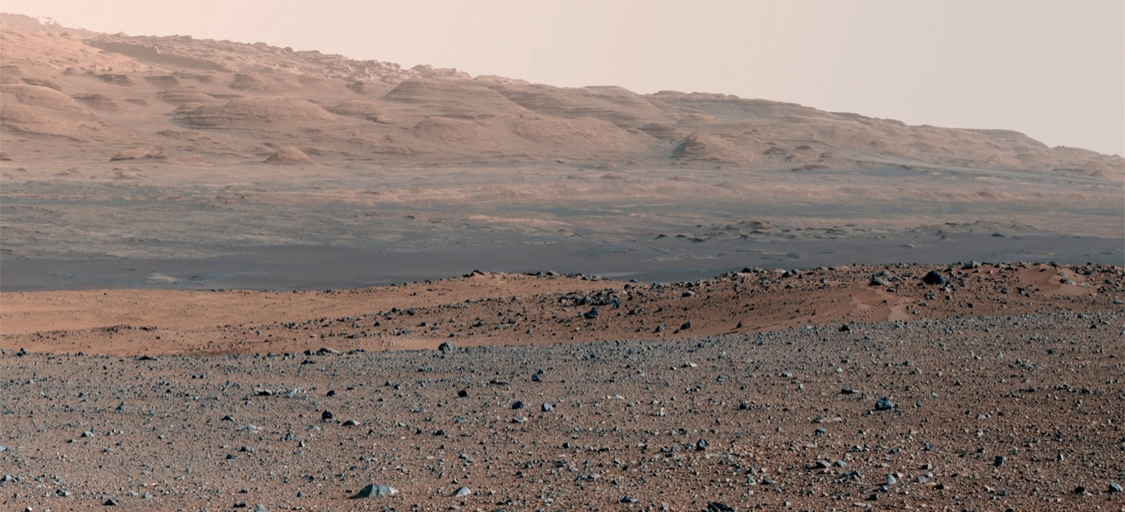

NASA/JPL-Caltech/MSSS
Initial Results from the
Mars Science Laboratory
Your Name Here
MSL Science Team
9/27/12

Slide 2
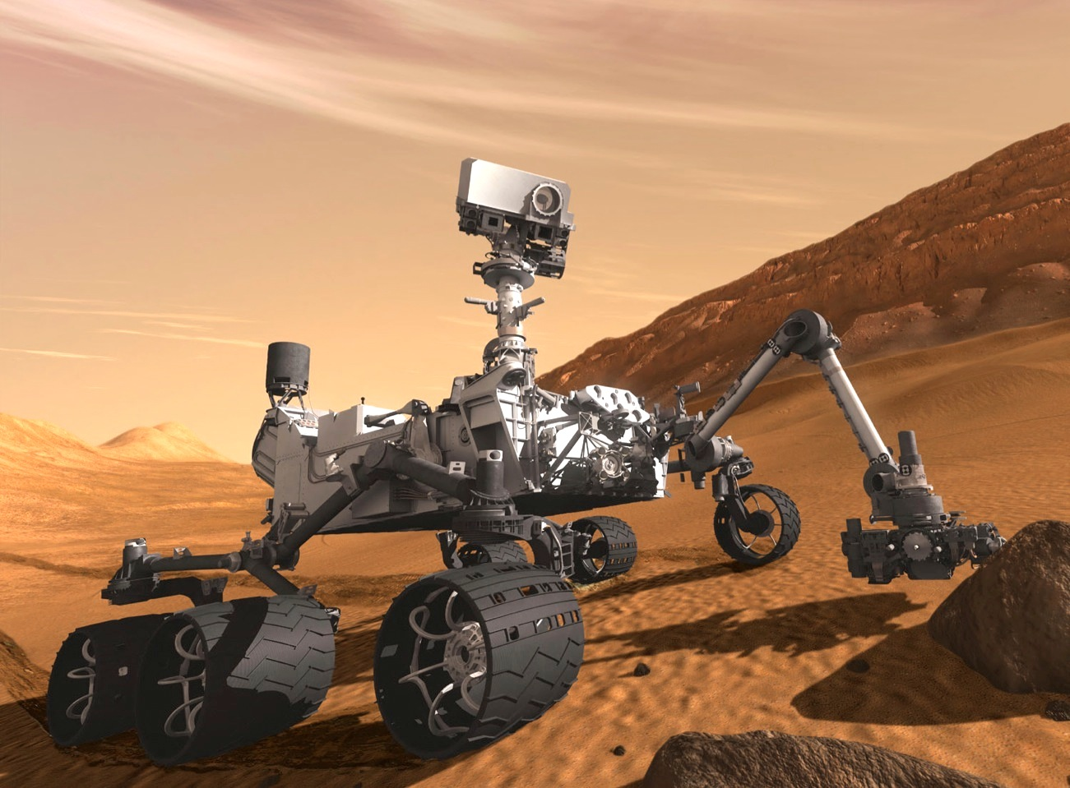

Curiosity’s primary scientific goal is to explore and quantitatively assess a local region on Mars’ surface as a potential habitat for life, past or present
Biological potential
Geology and geochemistry
Role of water
Surface radiation
NASA/JPL-Caltech
Curiosity’s Science Objectives

Slide 3
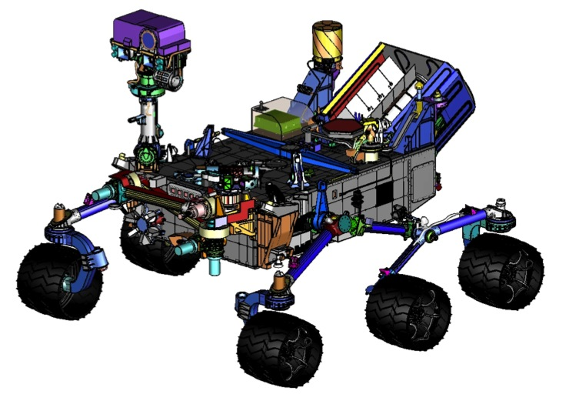
ChemCam
REMOTE SENSING
Mastcam (M. Malin, MSSS) - Color and telephoto imaging, video, atmospheric opacity
ChemCam (R. Wiens, LANL/CNES) – Chemical composition; remote micro-imaging
CONTACT INSTRUMENTS (ARM)
MAHLI (K. Edgett, MSSS) – Hand-lens color imaging
APXS (R. Gellert, U. Guelph, Canada) - Chemical composition
ANALYTICAL LABORATORY (ROVER BODY)
SAM (P. Mahaffy, GSFC/CNES/JPL-Caltech) - Chemical and isotopic composition, including organics
CheMin (D. Blake, ARC) - Mineralogy
ENVIRONMENTAL CHARACTERIZATION
MARDI (M. Malin, MSSS) - Descent imaging
REMS (J. Gómez-Elvira, CAB, Spain) - Meteorology / UV
RAD (D. Hassler, SwRI) - High-energy radiation
DAN (I. Mitrofanov, IKI, Russia) - Subsurface hydrogen
Mastcam
RAD
REMS
DAN
MAHLI
APXS
Brush
Drill / Sieves
Scoop
MARDI
Wheel Base: 2.8 m
Height of Deck: 1.1 m
Ground Clearance: 0.66 m
Height of Mast: 2.2 m
Mass: 900 kg
Curiosity’s Science Payload

Slide 4
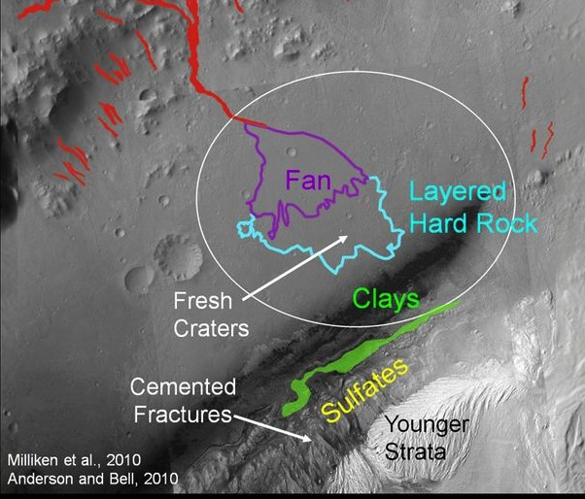
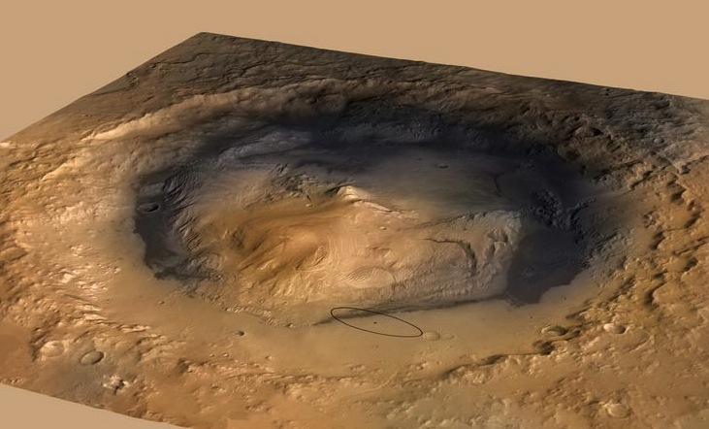
NASA/JPL-Caltech
NASA/JPL-Caltech/ESA/DLR/FU Berlin/MSSS
Target: Gale Crater and Mount Sharp

Slide 5
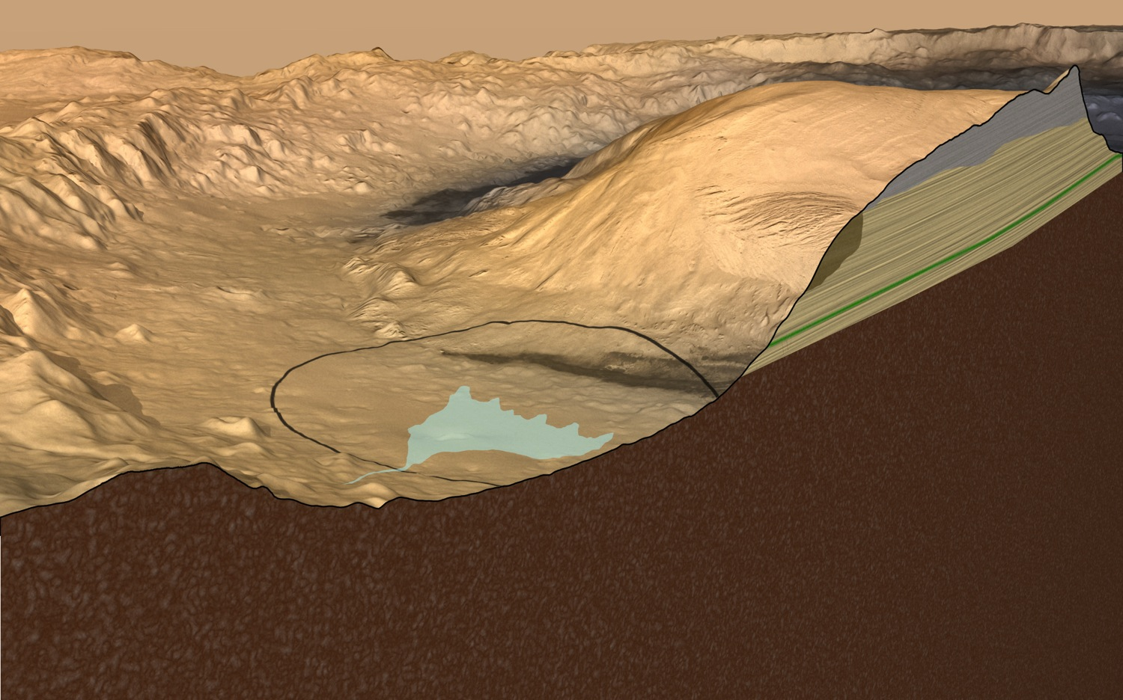
?
150-km Gale Crater contains a 5-km high mound of stratified rock. Strata in the lower section of the mound vary in mineralogy and texture, suggesting that they may have recorded environmental changes over time. Curiosity will investigate this record for clues about habitability, and the ability of Mars to preserve evidence about habitability or life.
NASA/JPL-Caltech/ESA/DLR/FU Berlin/MSSS
NASA/JPL-Caltech
Target: Gale Crater and Mount Sharp

Slide 6
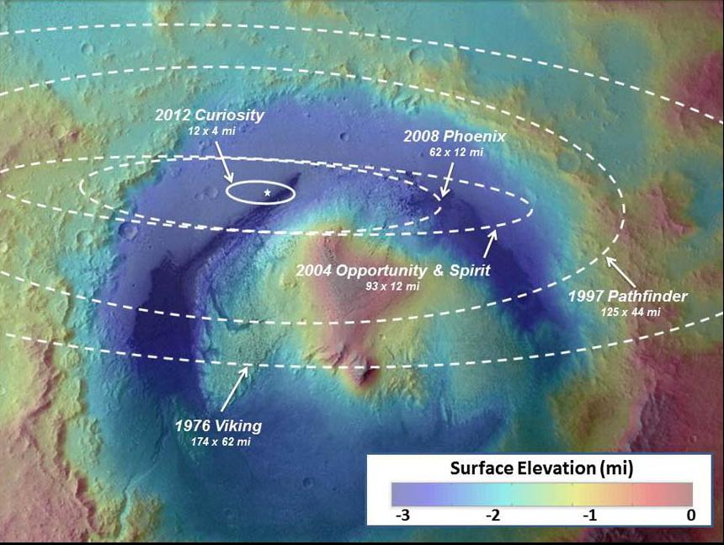
NASA/JPL-Caltech/ESA
Landing precision for Curiosity
and previous Mars surface missions

Slide 7
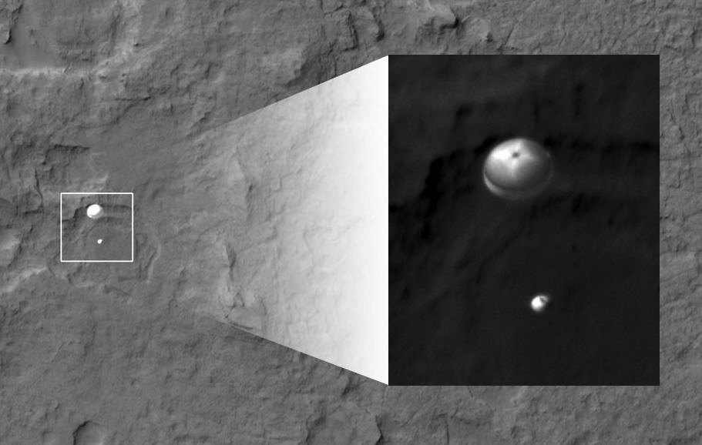
NASA/JPL-Caltech/Univ. of Arizona
Curiosity on parachute, imaged by
HiRISE on the Mars Reconnaissance Orbiter

Slide 8
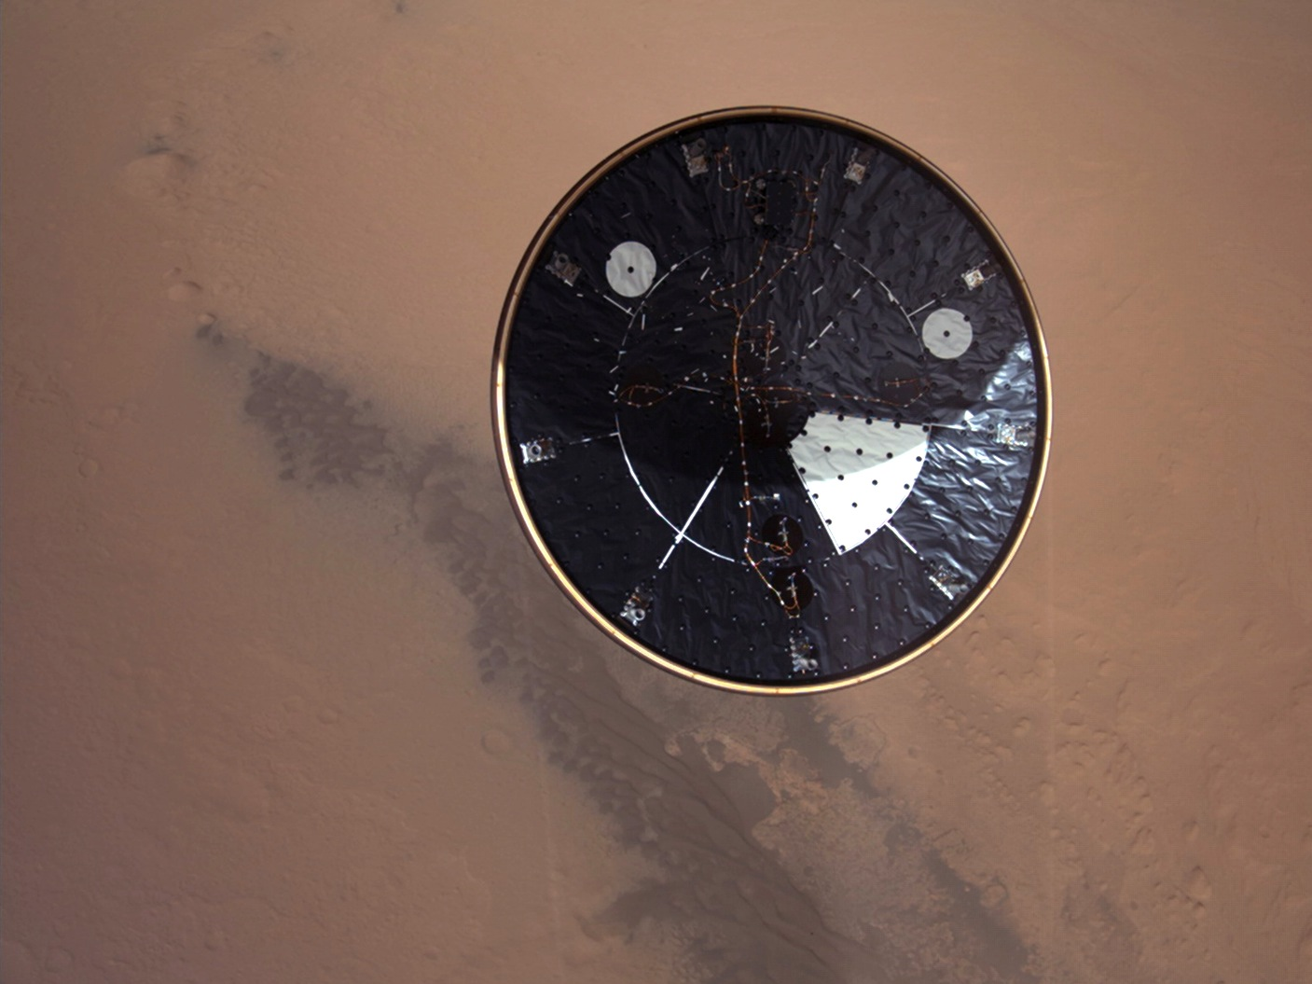
NASA/JPL-Caltech/MSSS
Heat shield separation captured
by Curiosity’s Mars Descent Imager

Slide 9
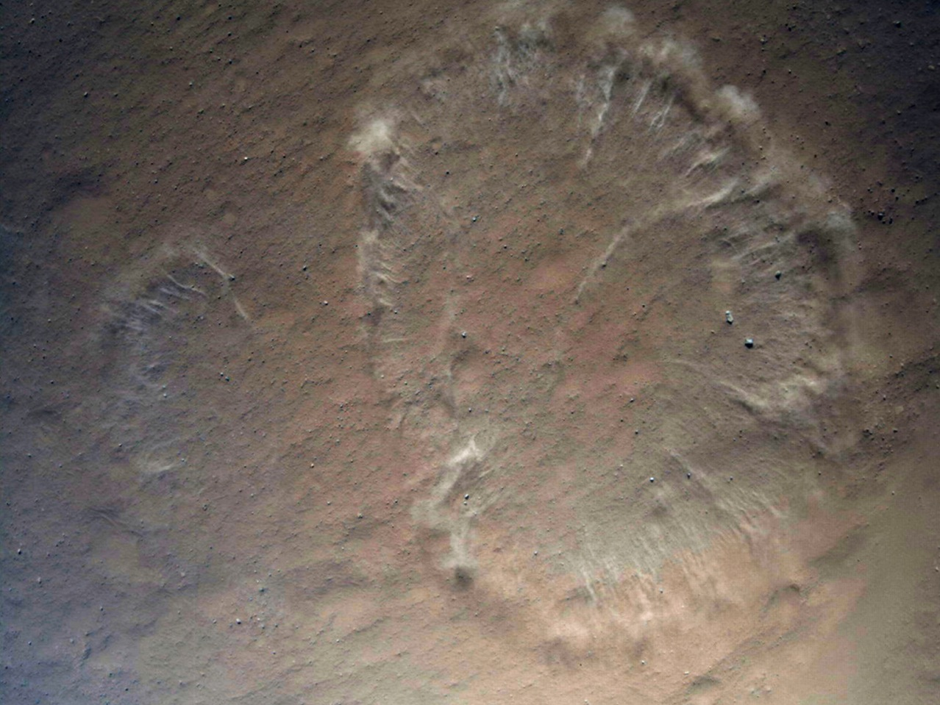
NASA/JPL-Caltech/MSSS
Kicking up dust just prior to landing

Slide 10
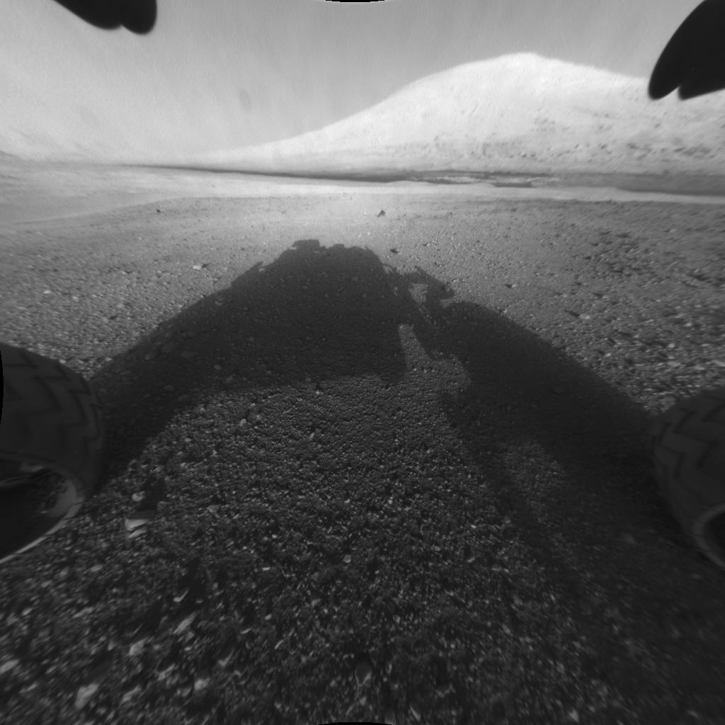
NASA/JPL-Caltech
“Touchdown confirmed.”
“Let’s see where Curiosity will take us.”

Slide 11
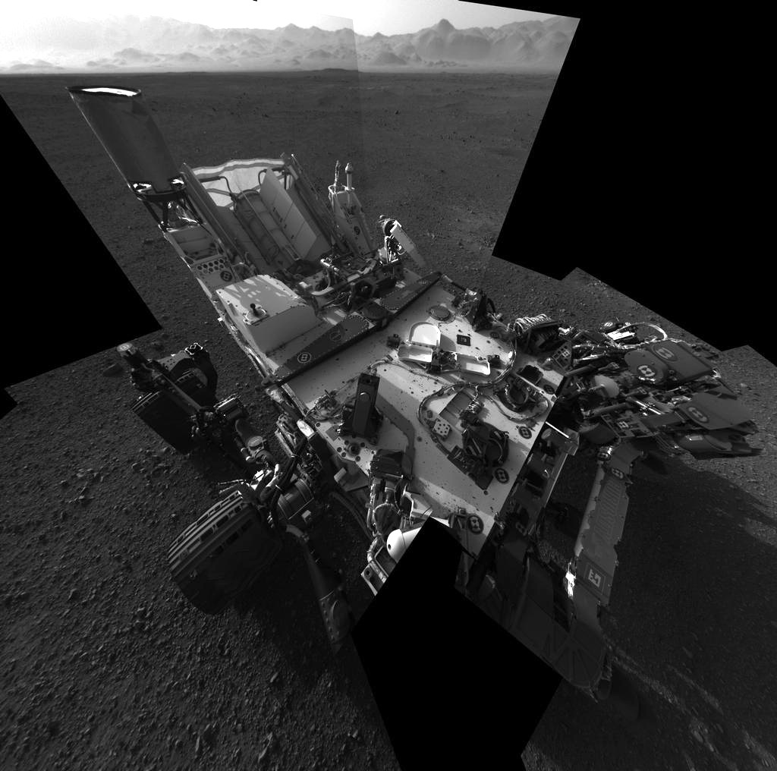
Curiosity self- portrait with navigation cameras
NASA/JPL-Caltech

Slide 12
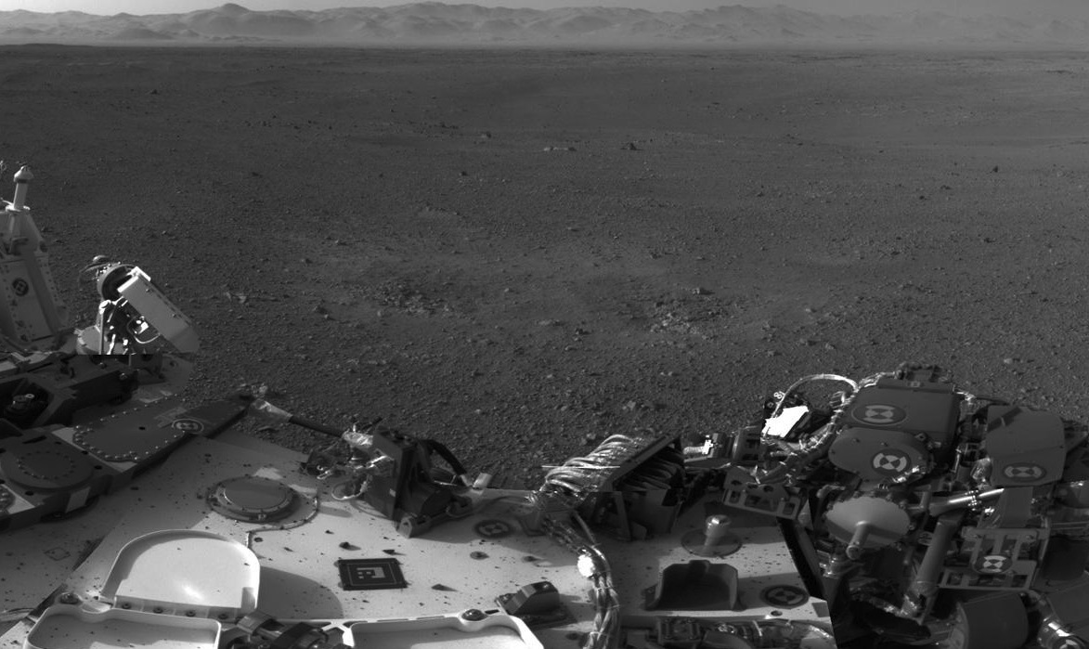
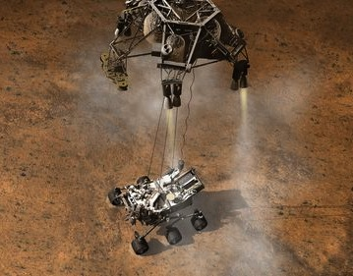
NASA/JPL-Caltech
Navigation camera image showing the surface scour marks and rocks on the rover’s deck

Slide 13
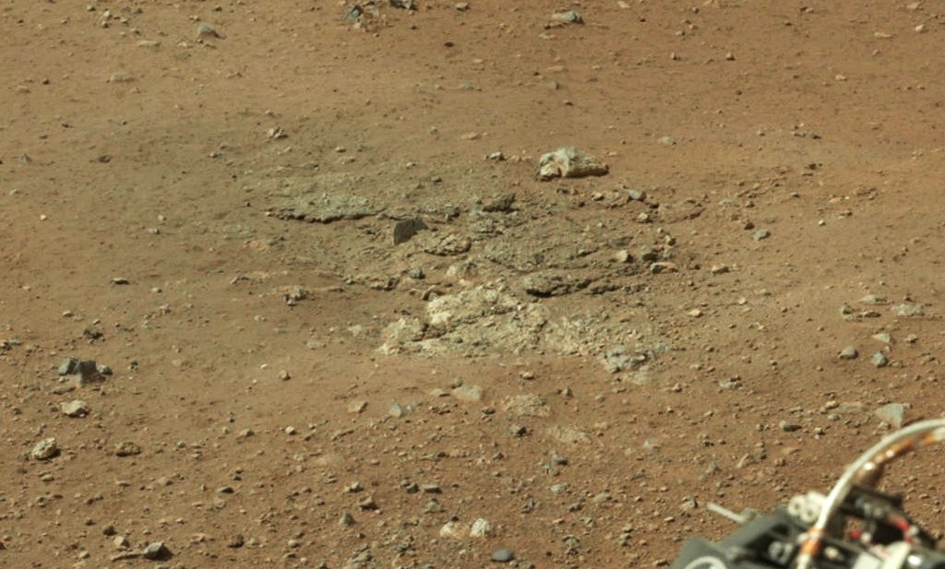
NASA/JPL-Caltech/MSSS
Bedrock exposed by the landing engines in the scour mark named Goulburn

Slide 14
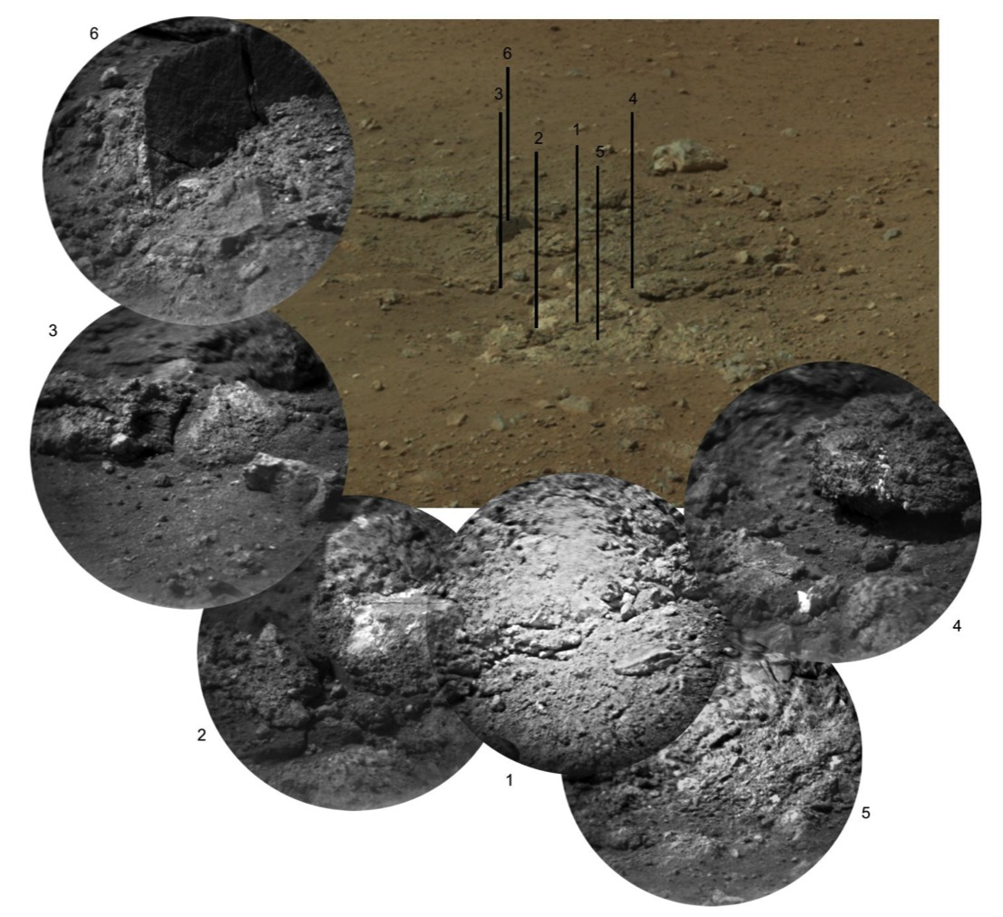
ChemCam’s Remote Micro-Imager acquires high-res images of the Goulburn scour
Each image is 10-12 cm (4-5”) across
NASA/JPL-Caltech/LANL/CNES/IRAP/MSSS

Slide 15
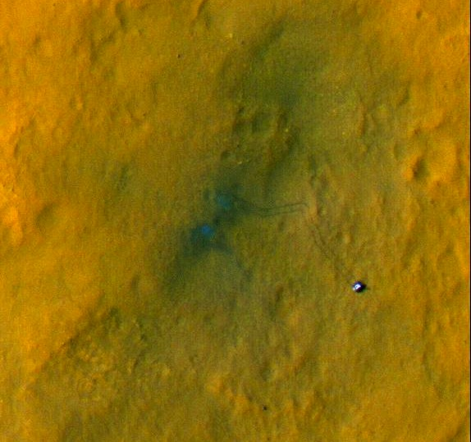
NASA/JPL-Caltech/Univ. of Arizona
Curiosity and its tracks captured by
HiRISE on the Mars Reconnaissance Orbiter

Slide 16
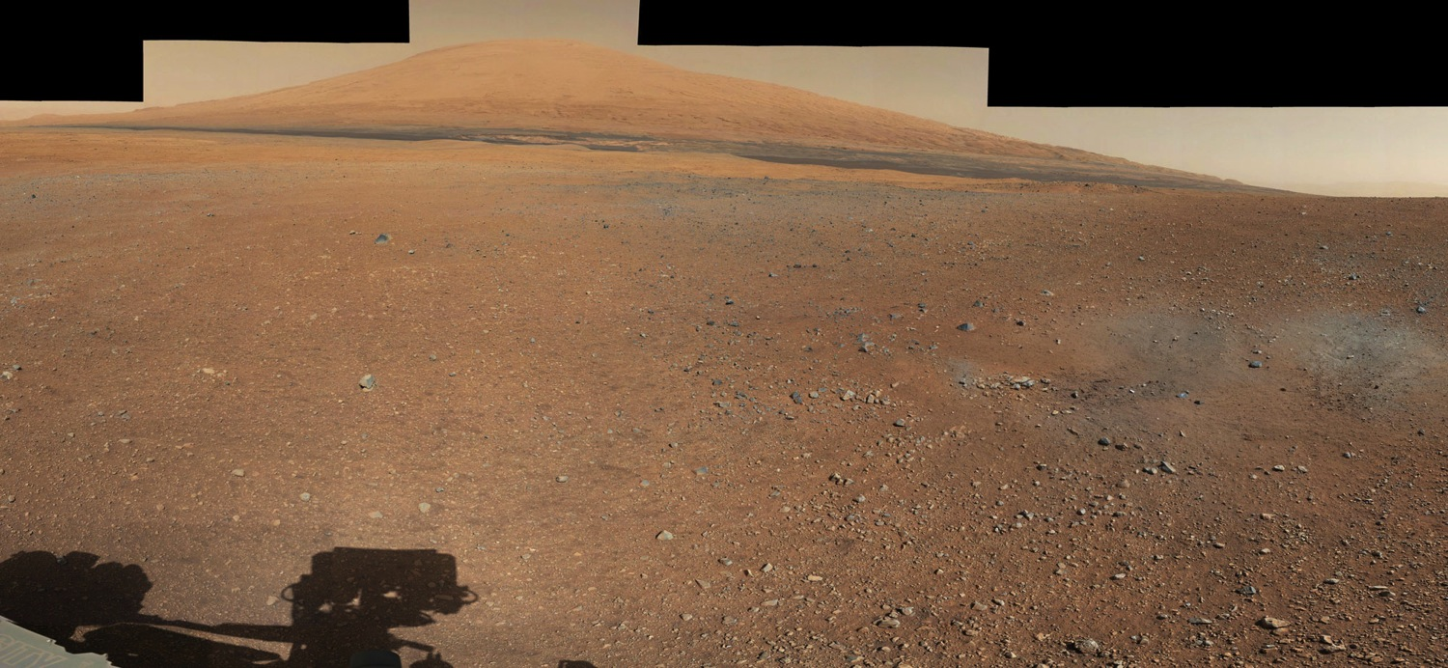
NASA/JPL-Caltech/MSSS
Mastcam-34 mosaic of Mount Sharp, descent rocket scours, and rover shadow

Slide 17
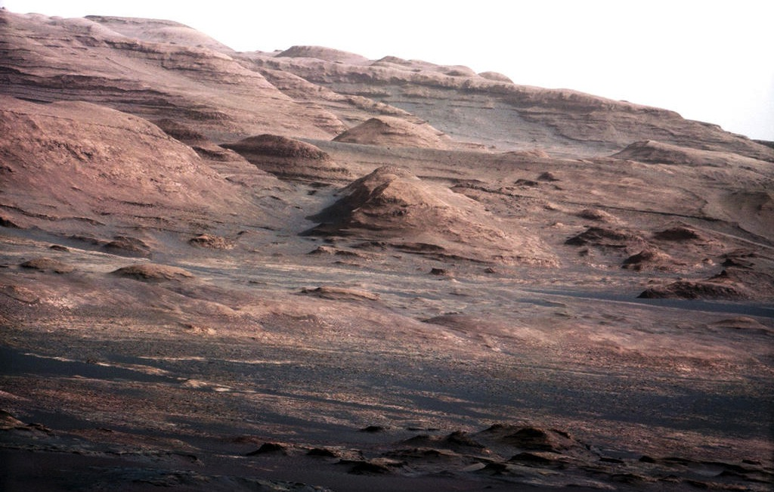
This boulder is the size of Curiosity
NASA/JPL-Caltech/MSSS
Mastcam-100 image of Mount Sharp’s layers, canyons and buttes

Slide 18
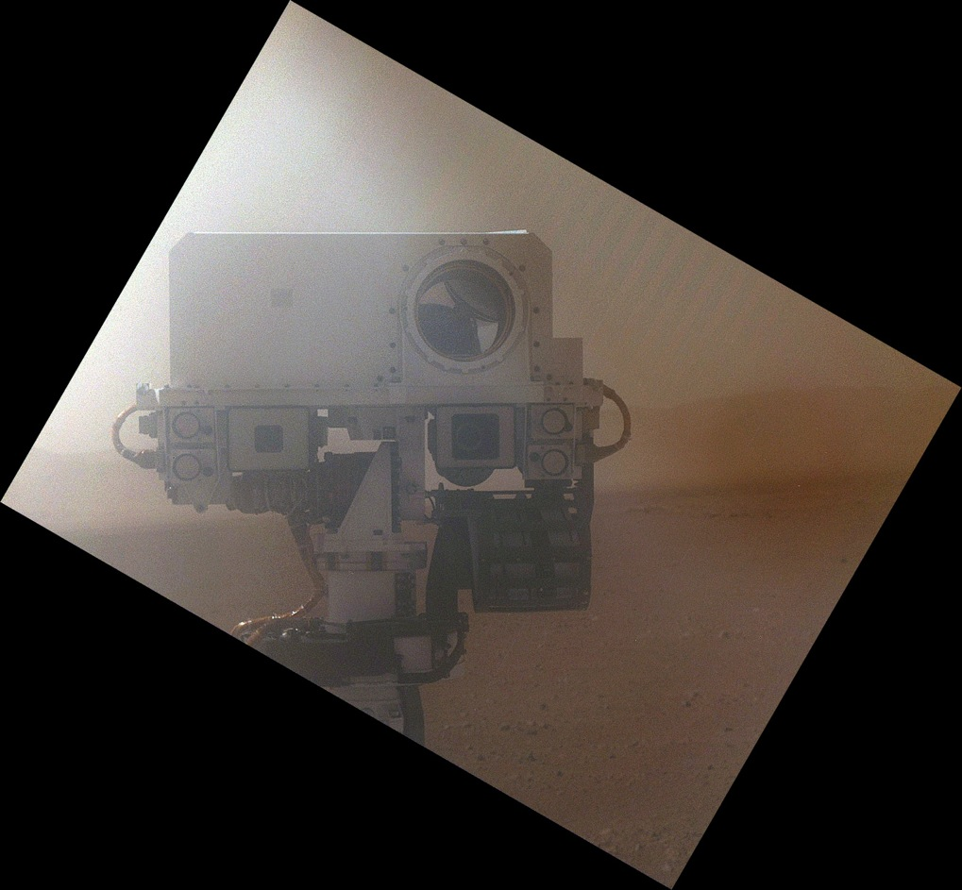
NASA/JPL-Caltech/MSSS
Curiosity self-portrait using the arm-mounted Mars Hand-Lens Imager, through dust cover

Slide 19
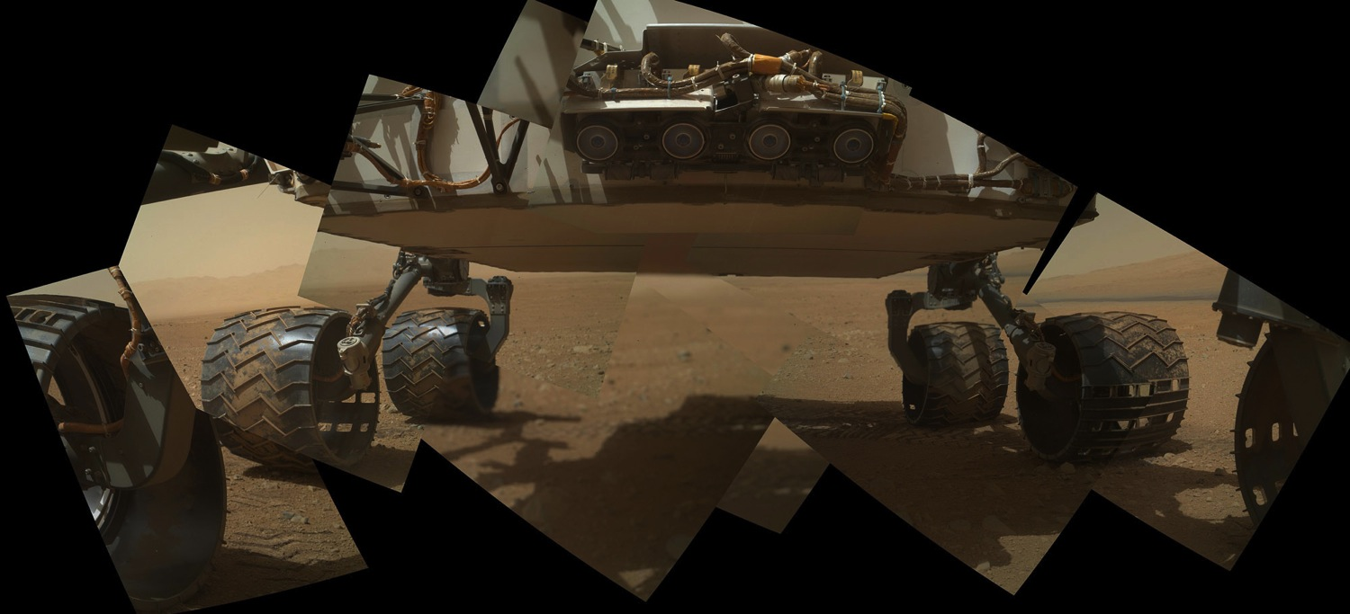
NASA/JPL-Caltech/MSSS
Curiosity images its undercarriage
with its Mars Hand-Lens Imager

Slide 20
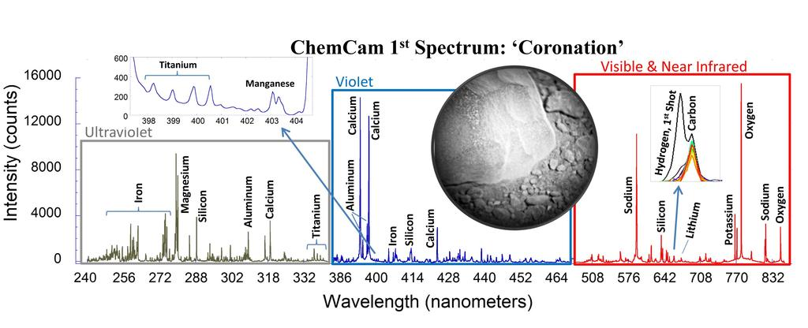
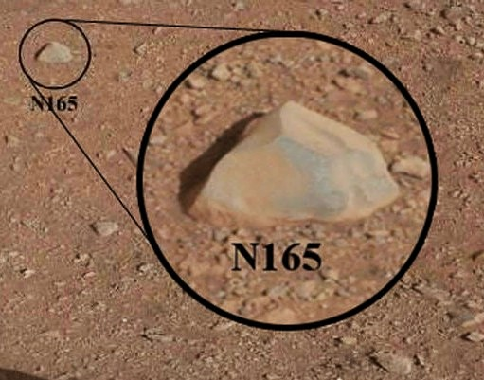
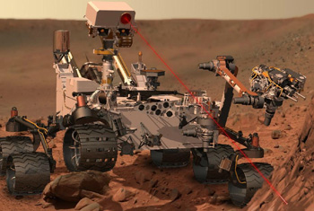
NASA/JPL-Caltech/LANL/CNES/IRAP/MSSS
NASA/JPL-Caltech/LANL/CNES/IRAP
ChemCam spectra of Coronation
Target: Coronation (N165)
Sol 13
Shots: 30
NASA/JPL-Caltech/LANL/CNES/IRAP/MSSS
NASA/JPL-Caltech/MSSS

Slide 21
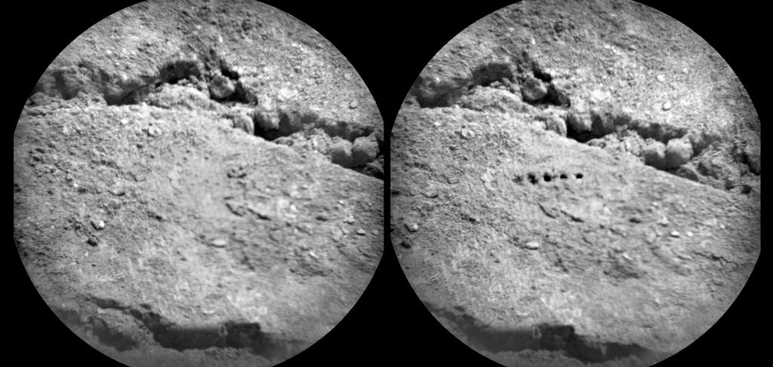
Target: Beechey (Sol 19)
Power: 1 Gigawatt
Shots per spot: 50
Before
After
8 cm(3”)
NASA/JPL-Caltech/LANL/CNES/IRAP/LPGN/CNRS
ChemCam’s laser induced breakdown spectrometer acquires a 5-spot raster

Slide 22
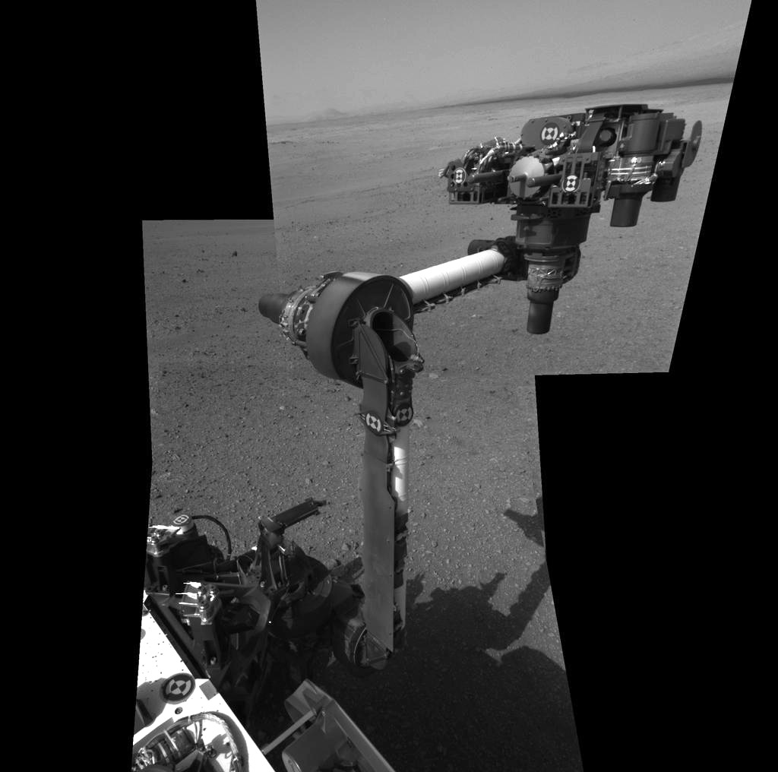
Navigation camera mosaic of Curiosity’s robotic arm
NASA/JPL-Caltech

Slide 23
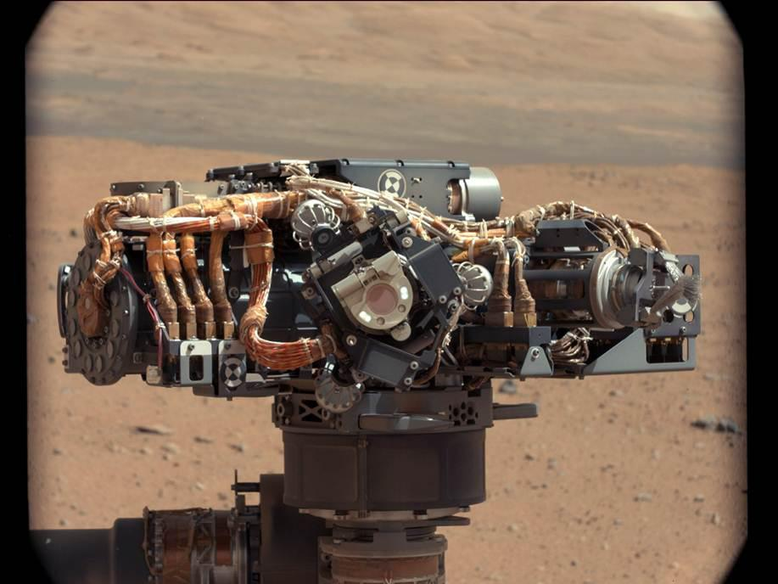
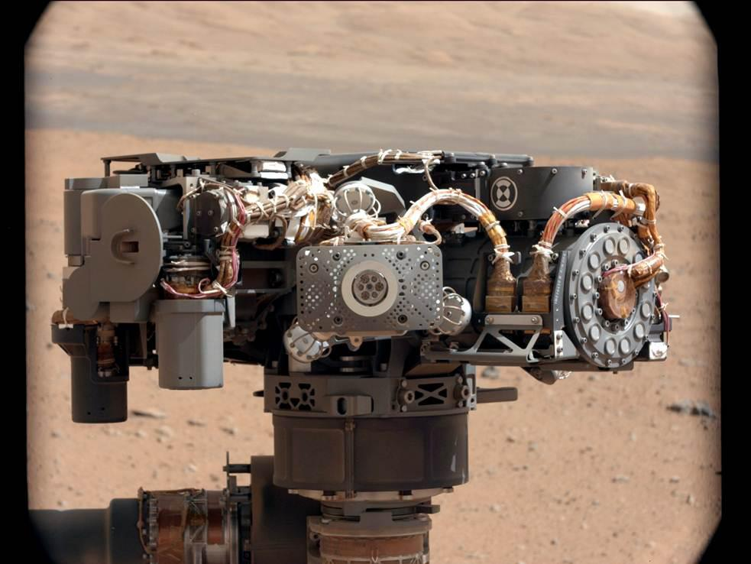
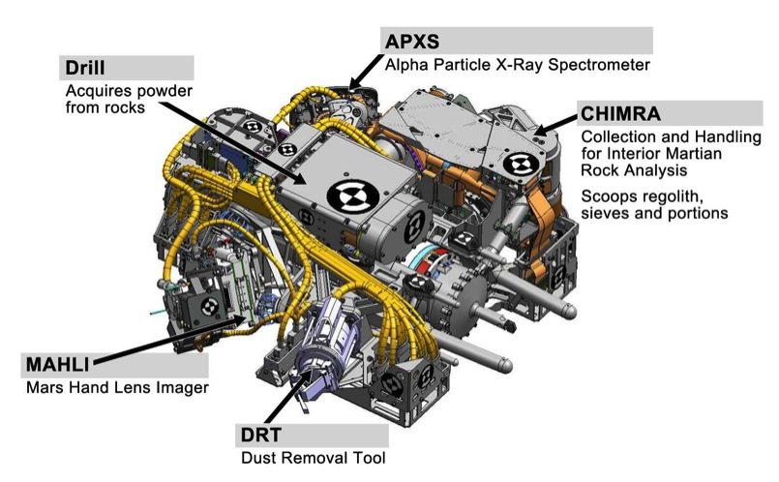
NASA/JPL-Caltech/MSSS
Images of Curiosity’s turret centered
on MAHLI (left) and APXS (right)

Slide 24
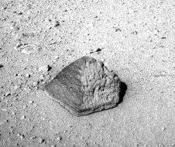
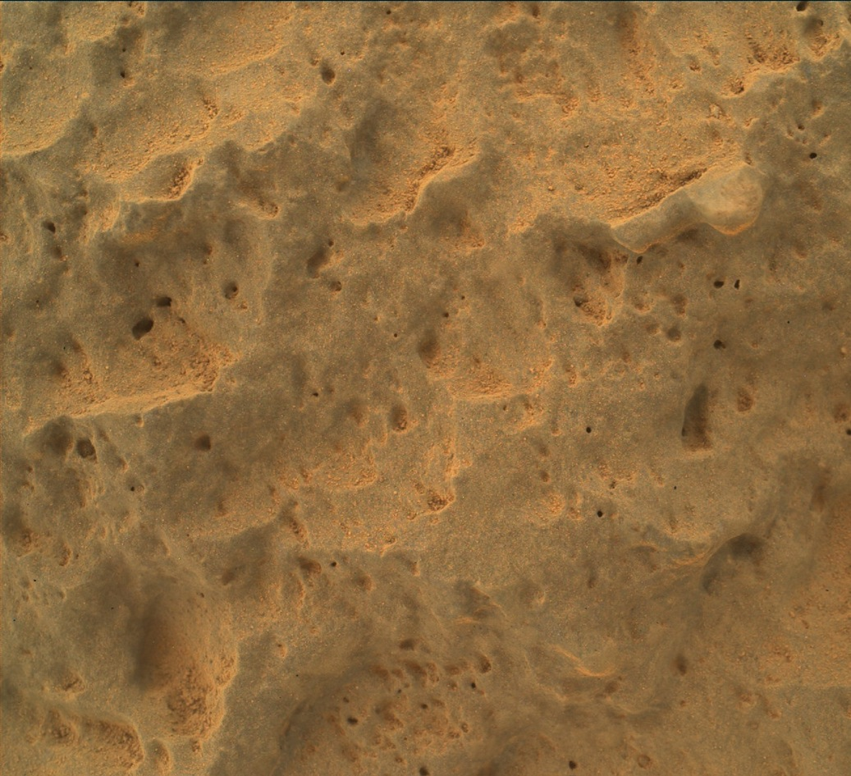
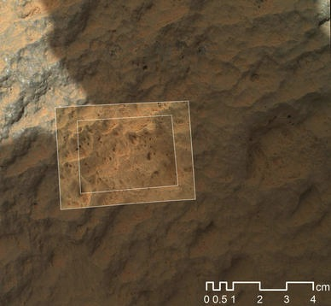
NASA/JPL-Caltech/MSSS
Nested, hand-lens imaging of the 25-cm (10”) high rock Jake Matijevic

Slide 25
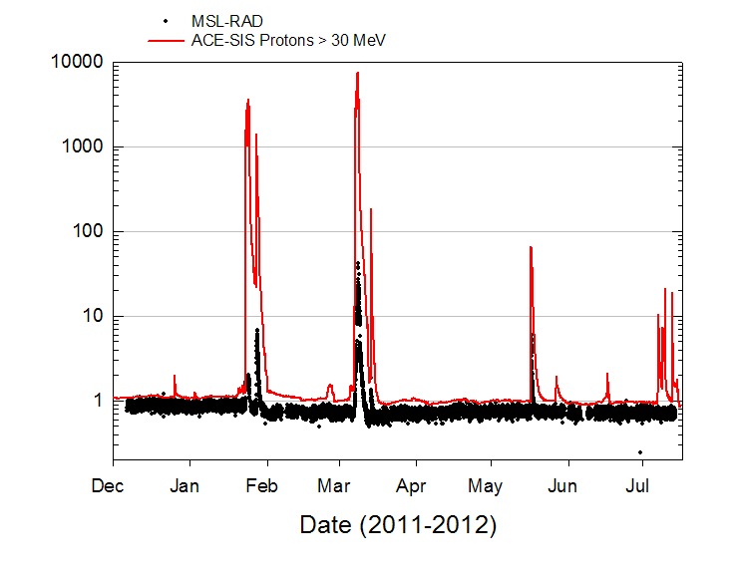
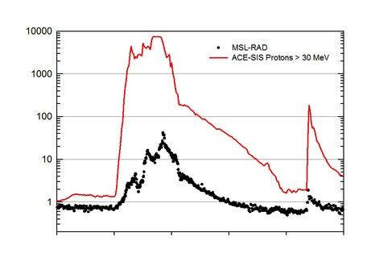
RAD observed galactic cosmic rays and five solar energetic particle events
Particle Flux (protons/cm²/s/sr)
05
09
11
13
15
RAD was shielded by the spacecraft structure, reducing the observed particle flux relative to NASA’s ACE satellite
Day (March 2012)
Particle Flux (protons/cm²/s/sr)
RAD is now collecting the first measurements of the radiation environment on the surface of another planet
NASA/JPL-Caltech/SwRI
Curiosity’s Radiation Assessment Detector operated throughout the cruise to Mars

Slide 26
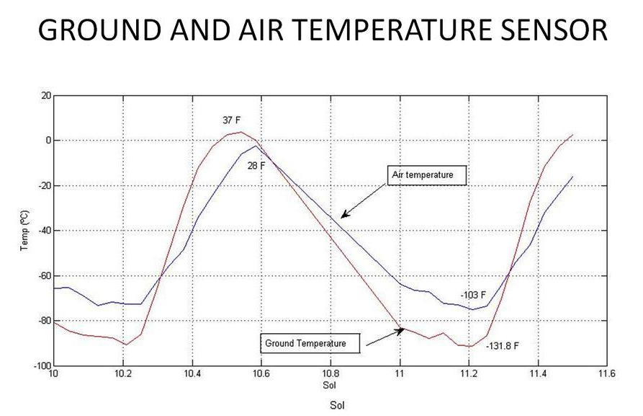
REMS’ ground and air temperature sensors are located on small booms on the rover’s mast
The ground temperature changes by 90°C (170 degrees Fahrenheit) between day and night
The air is warmer than the ground at night, and cooler during the morning, before it is heated by the ground
NASA/JPL-Caltech/CAB(CSIC-INTA)
Curiosity’s Rover Environmental Monitoring Station is taking weather readings 24 × 7

Slide 27
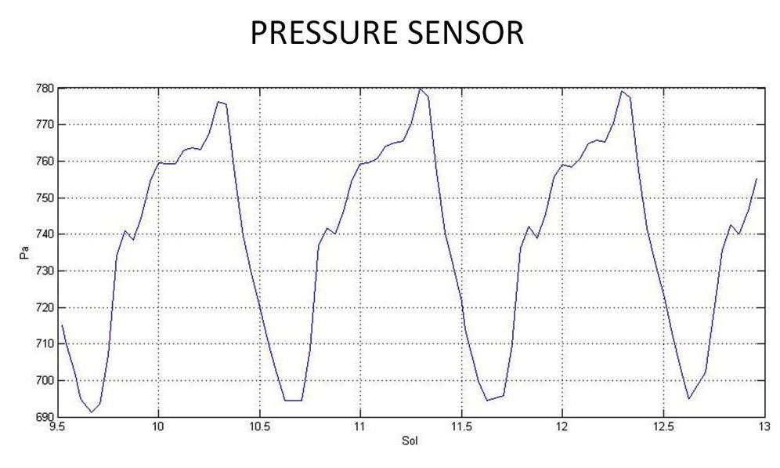
REMS’ pressure sensor is located inside the rover’s body
Each day the pressure varies by over 10%, similar to the change in pressure between Los Angeles and Denver
Solar heating of the ground drives an atmospheric “tidal wave” that sweeps across the planet each day
NASA/JPL-Caltech/CAB(CSIC-INTA)
Earth’s atmosphere = 101,325 Pascals, or about 140 times the pressure at Gale Crater
Curiosity’s Rover Environmental Monitoring Station is taking weather readings 24 × 7

Slide 28
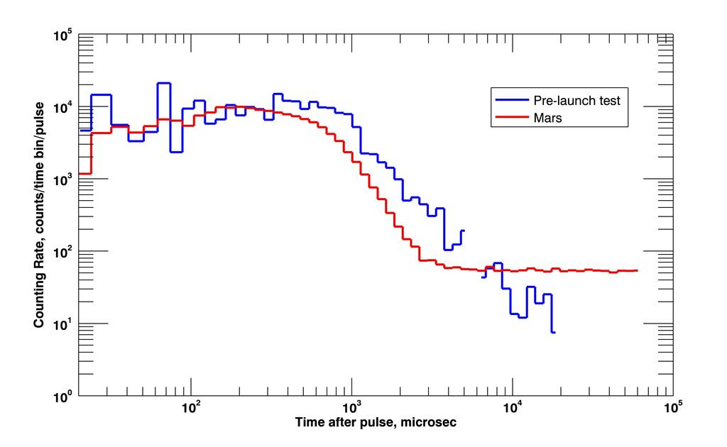
DAN sends ten million neutrons into the ground, ten times a second
The “echo” back is recorded. If hydrogen is present in the ground, perhaps in aqueous minerals, some neutrons will collide and lose energy
DAN is used to survey the upper one meter of the ground below the rover as it drives along
NASA/JPL-Caltech/Russian Space Research Institute
Curiosity’s Dynamic Albedo of Neutrons experiment sounds the ground for hydrogen

Slide 29
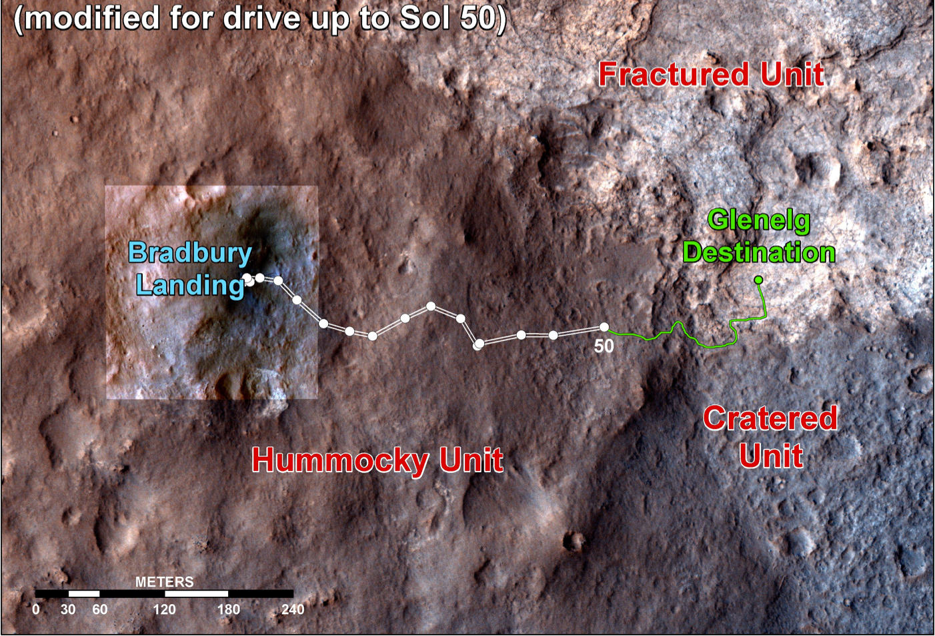
NASA/JPL-Caltech/Univ. of Arizona
Curiosity is progressing toward Glenelg, where three distinct terrain types meet

Slide 30
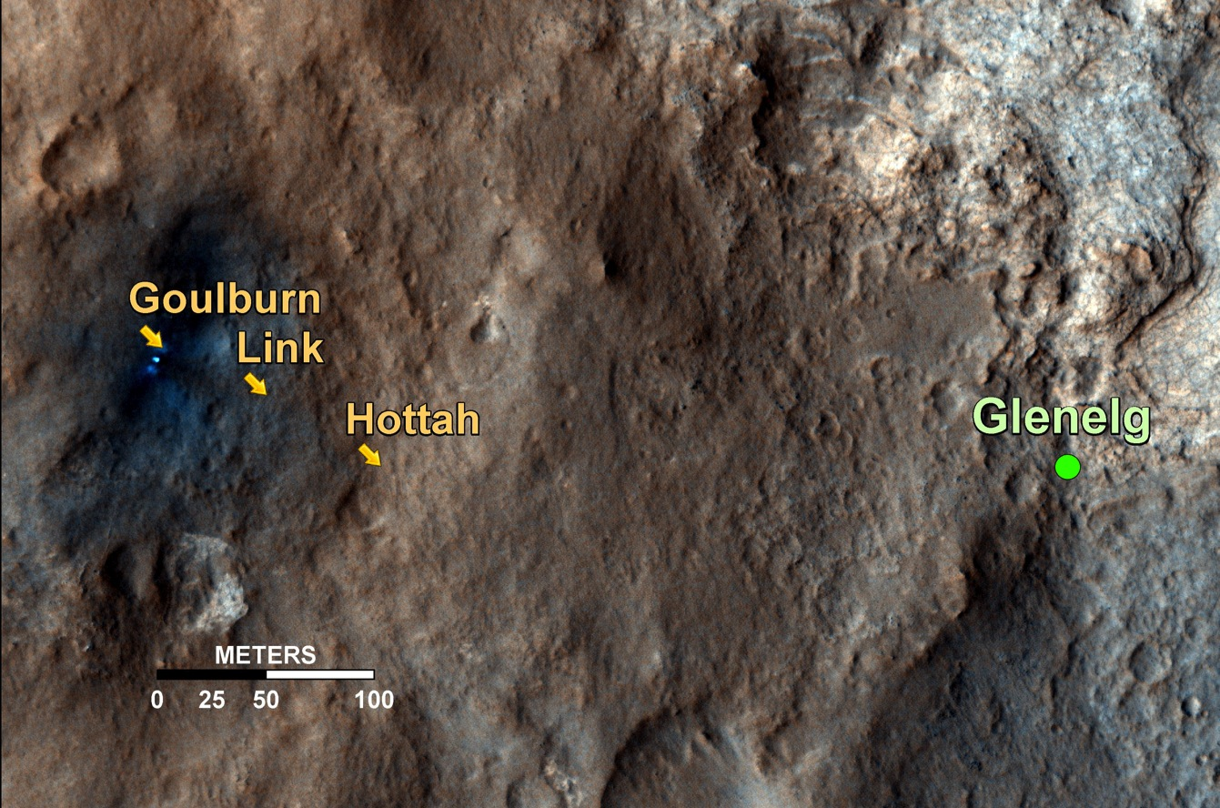
NASA/JPL-Caltech/Univ. of Arizona
Map view of conglomerate outcrops (next slides)

Slide 31
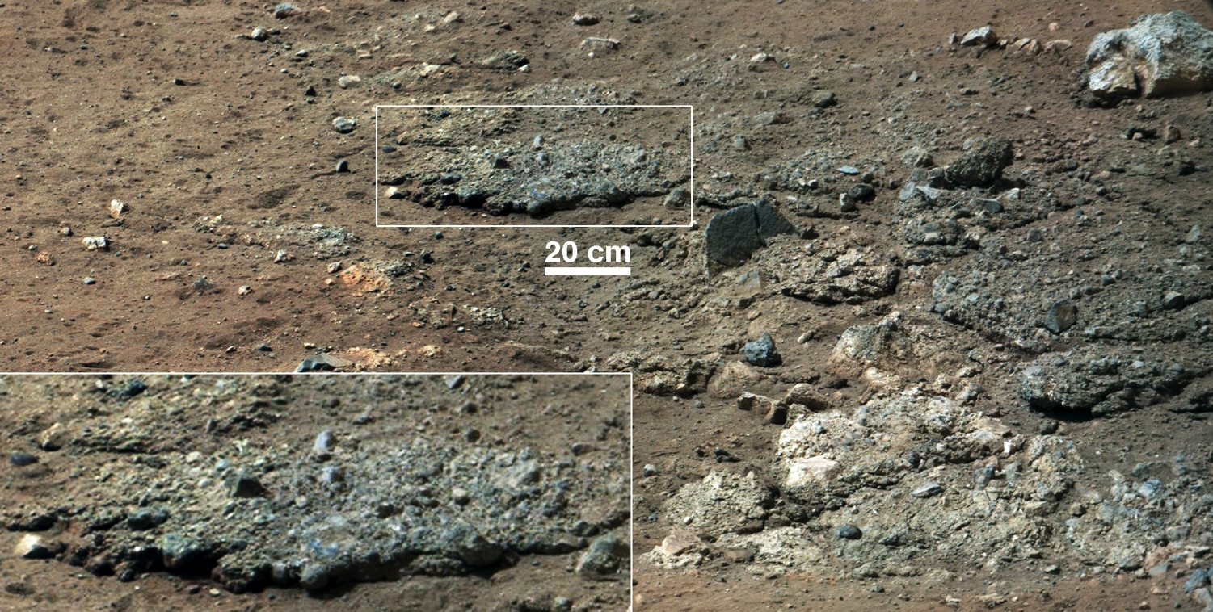
NASA/JPL-Caltech/MSSS
The Goulburn scour revealed the first look at underlying bedrock

Slide 32
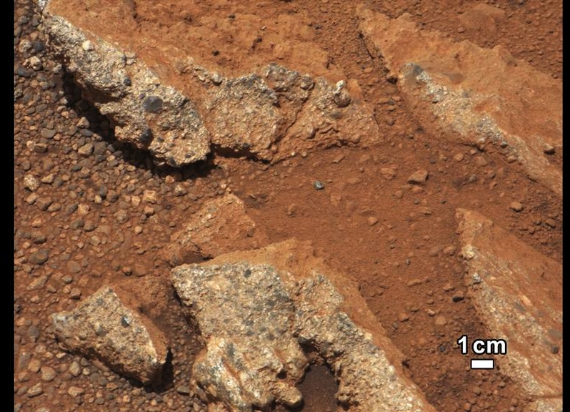
NASA/JPL-Caltech/MSSS
The conglomerate “Link” with associated loose, rounded pebbles

Slide 33
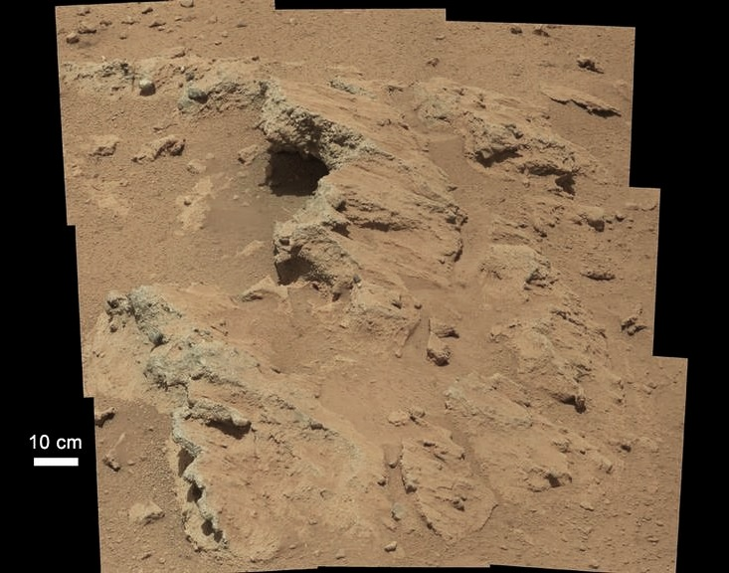
NASA/JPL-Caltech/MSSS
“Hottah” reveals additional conglomerate, evidence of an ancient streambed

Slide 34
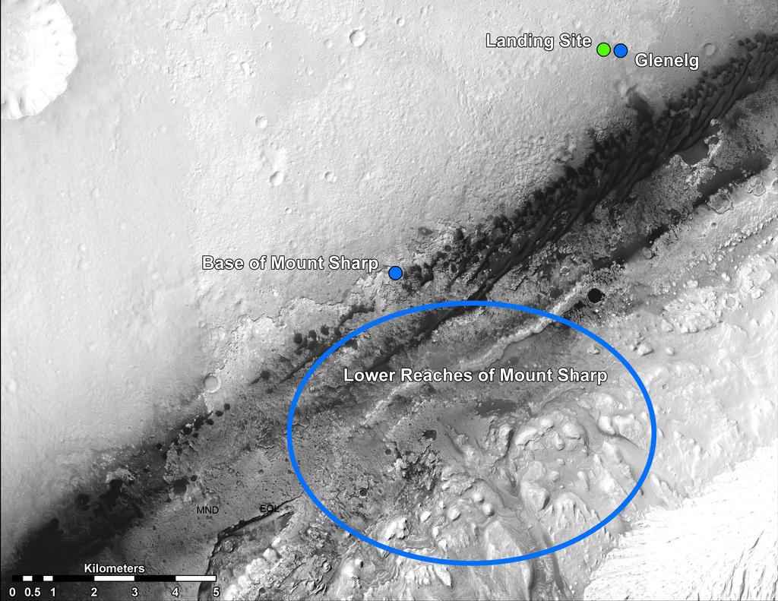
NASA/JPL-Caltech/Univ. of Arizona
Curiosity’s ultimate goal is to explore the lower reaches of the 5-km high Mount Sharp

